Slide 1
CNN Architecture and Transfer learning with PyTorch

Slide 2
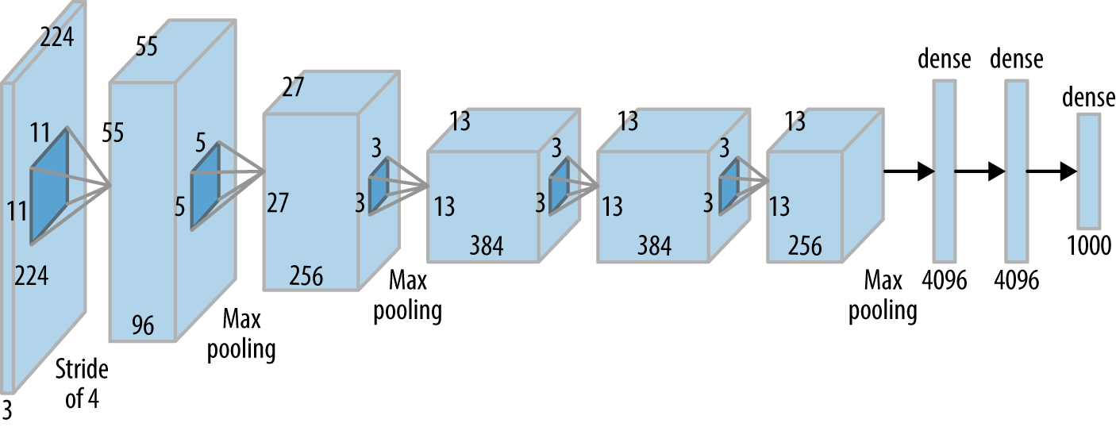
Alex Net

Slide 3
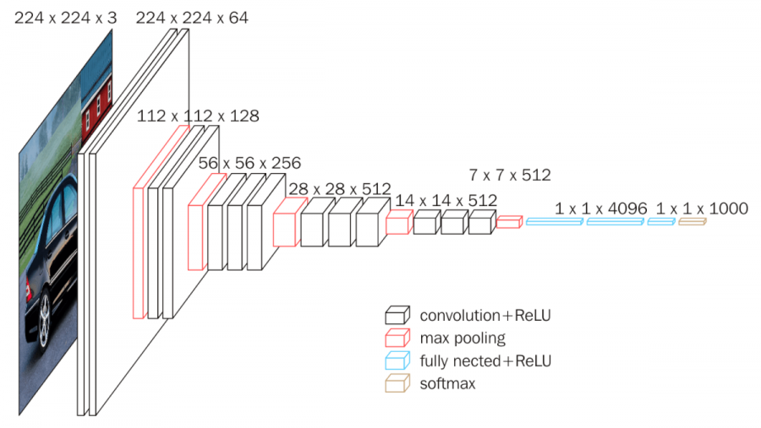
VGG Network

Slide 4
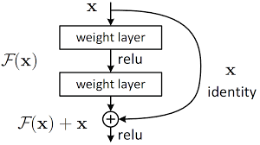
ResNet

Slide 5
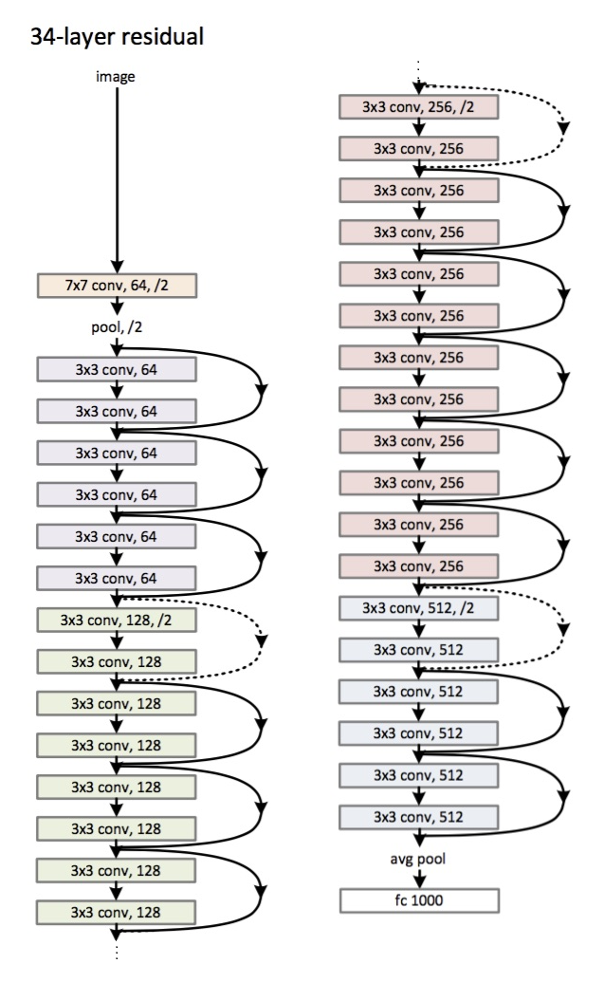

Slide 6
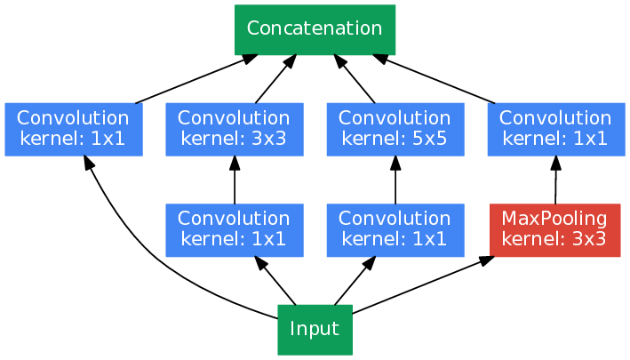
GoogleNet

Slide 7
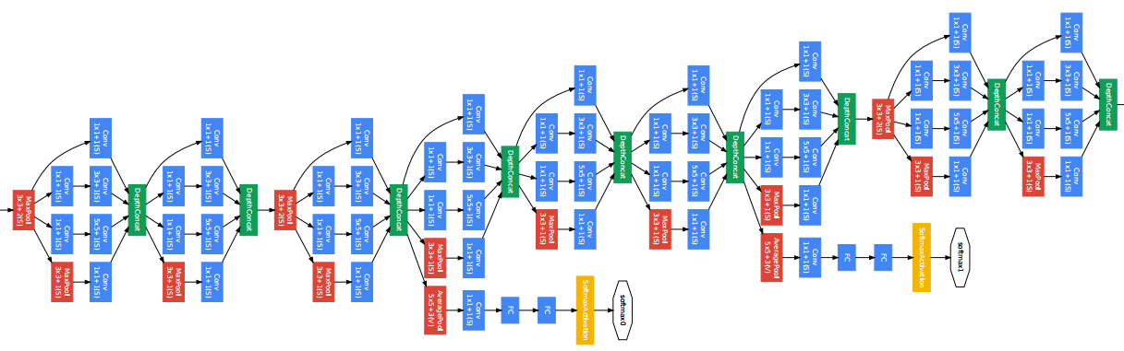

Slide 8
Transfer learning
Using a model trained with a different dataset (but similar to your dataset) for your application.
By using this technique, we are making it easier for our optimization algorithm to converge faster.
With transfer learning, we are using the low-level features extracted by the pre-trained model for our application.
We use transfer learning usually when we don’t have enough data for our application.
CNN architectures are pre-trained with the ImageNet dataset which has 1000 different categories

